Slide 1

Project : Amazon sales Analysis
By HARI PRIYA GUDE

Slide 2

Introduction
Welcome to the presentation on our capstone project analyzing sales data from Amazon's three branches located in Mandalay, Yangon, and Naypyitaw. The primary objective of this project is to gain valuable insights into the factors affecting sales across these branches and to understand various aspects such as product performance, sales trends, customer behavior, and profitability.
Objectives:
Understand the sales data of Amazon branches.
Analyze different product lines and their performance.
Identify sales trends and their effectiveness.
Uncover customer segments and purchase trends.
Provide actionable recommendations based on insights derived from the analysis
Dataset Overview: Our dataset comprises 1000 sales transactions, including 17 columns capturing various aspects of each transaction. These columns include information such as invoice ID, branch location, customer type, product line, unit price, quantity, total cost, date, time, payment method, and ratings, among others.

Slide 3
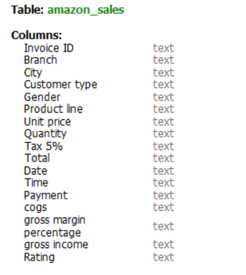

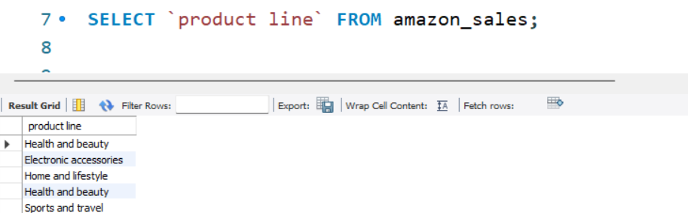
Data wrangling
2.Tools Used:Mysql
1. Building the Database:
Step1:created a database : amazon
Step2:create a table called:amazon_sales
Step3:inserted data using Table wizard Import option
have encountered an issue: Spaces in column names
Solution : use `product line` (backtips)

Slide 4
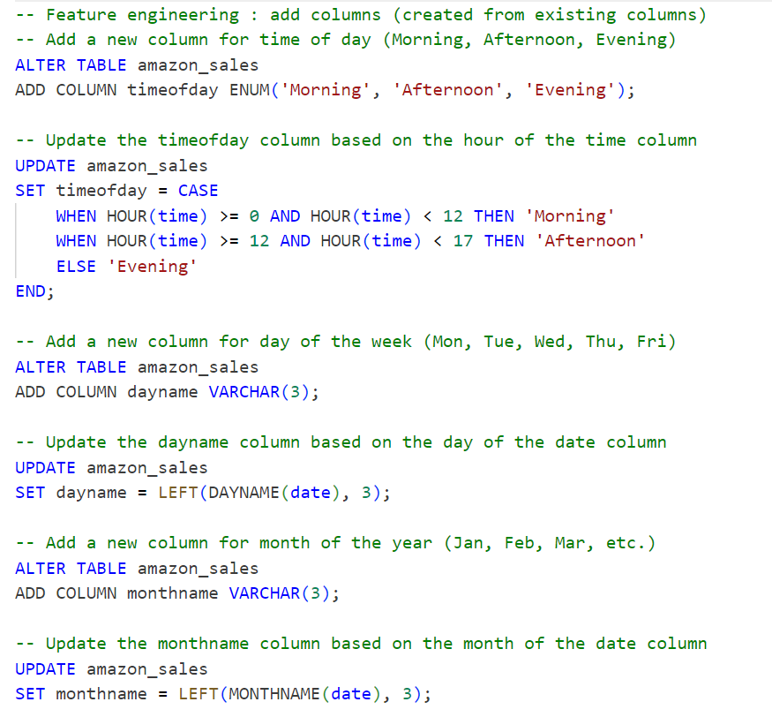
Feature ENGINEERING
1 Adding Timeofday Column:
We introduced a new column named "timeofday" to categorize sales transactions into different parts of the day: Morning, Afternoon, and Evening. This enables us to analyze sales patterns based on the time of day and identify the peak hours when most sales occur.
2 Adding Dayname Column:
Another important feature we added is the "dayname" column, which extracts the day of the week (e.g., Mon, Tue, Wed) from the date of each transaction. This allows us to understand the distribution of sales across different days of the week and determine which days are busiest for each branch.
3 Adding Monthname Column:
To analyze seasonal trends in sales, we created the "monthname" column, which extracts the month (e.g., Jan, Feb, Mar) from the transaction date. This enables us to identify the months with the highest sales and profitability, providing valuable insights for planning and forecasting.

Slide 5
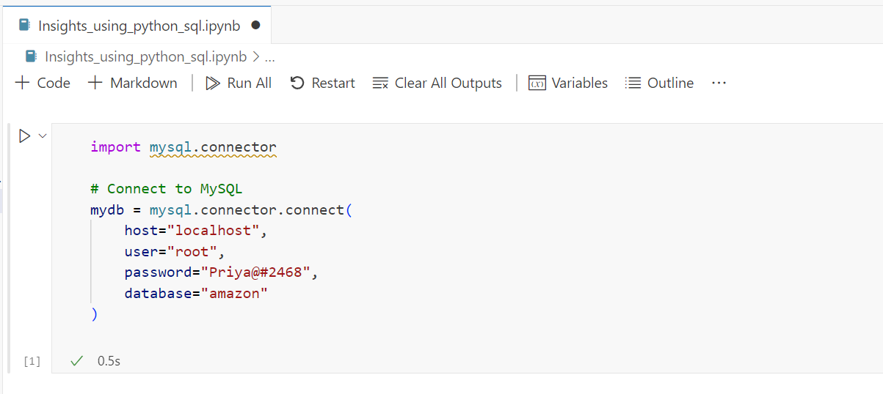

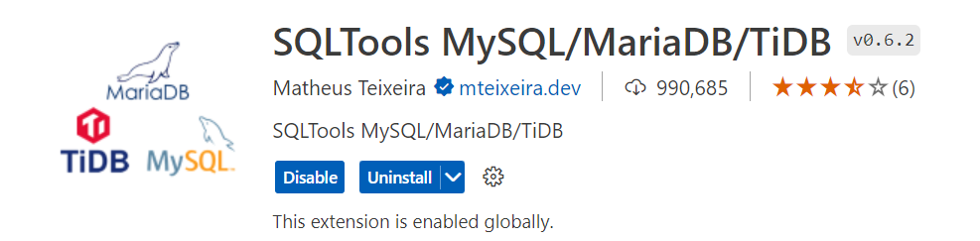
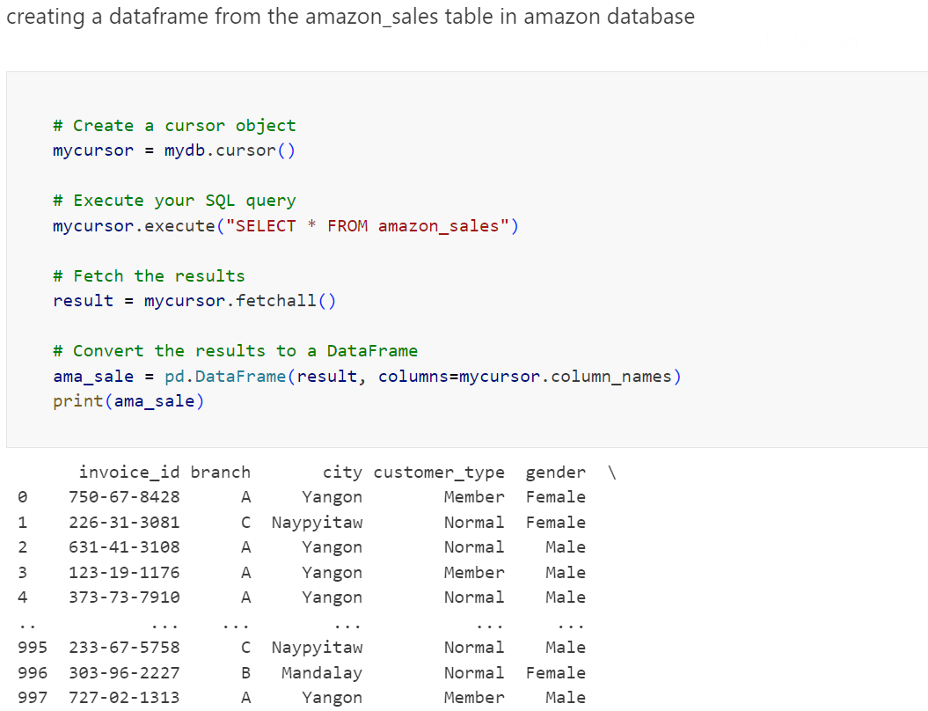
using vscode with mysql database
Extensions used in vscode for the connection:

Slide 6
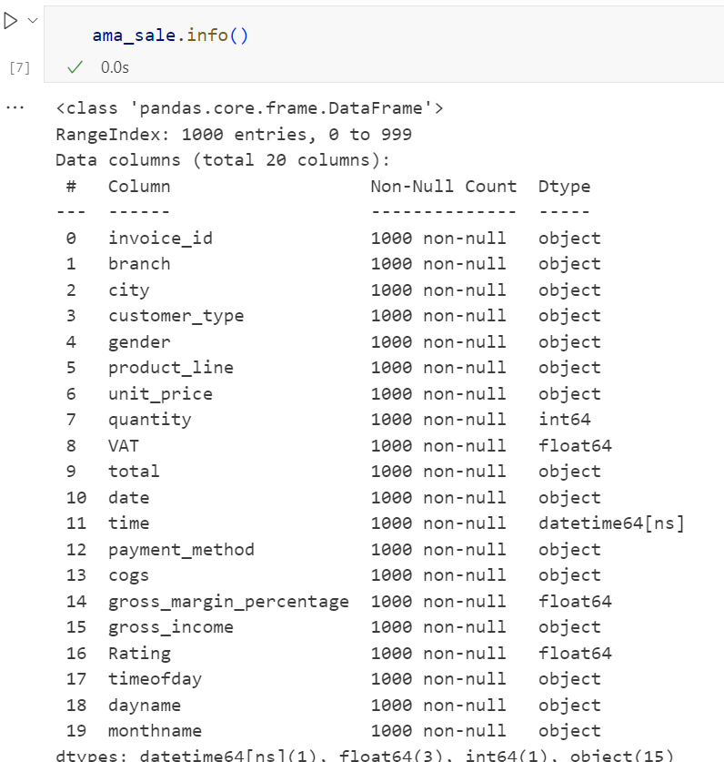
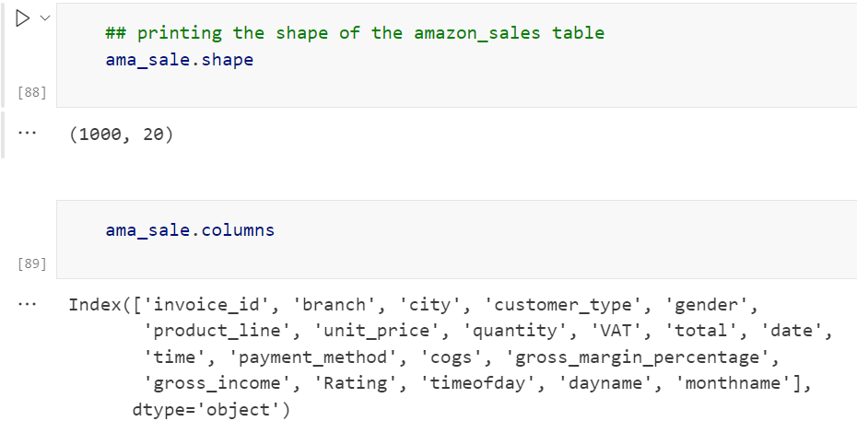
Exploratory Data Analysis (EDA) Part-1

Slide 7
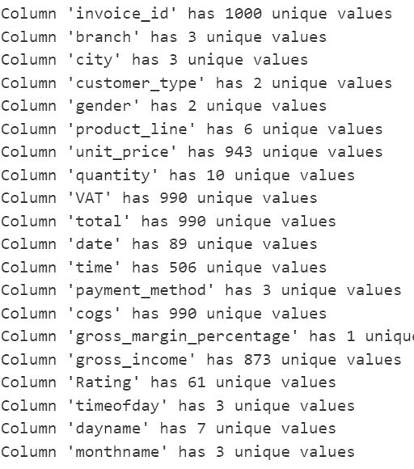
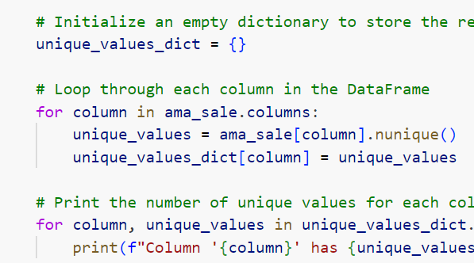
Exploratory Data Analysis (EDA) Part-2(unique values)

Slide 8
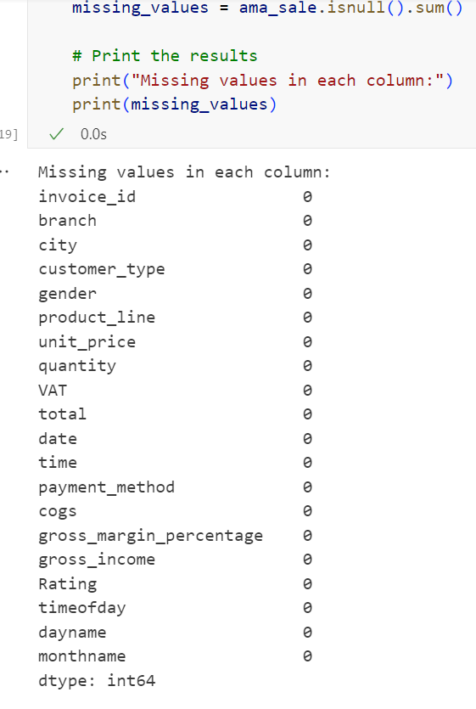
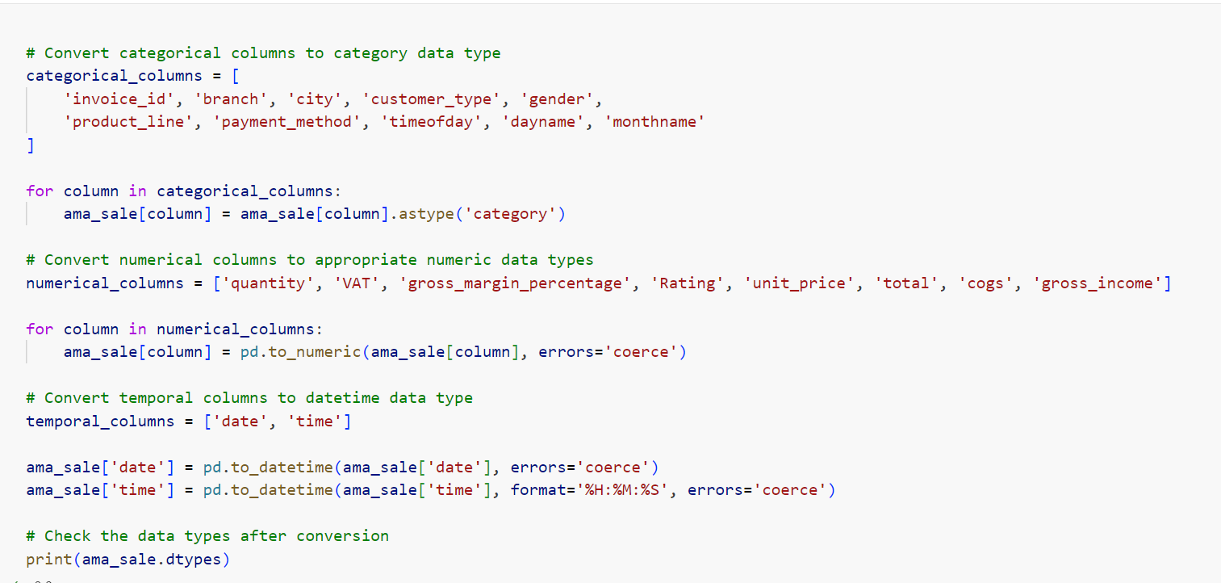
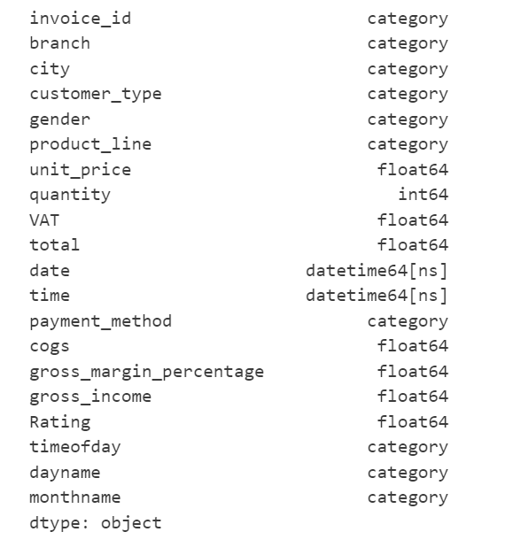
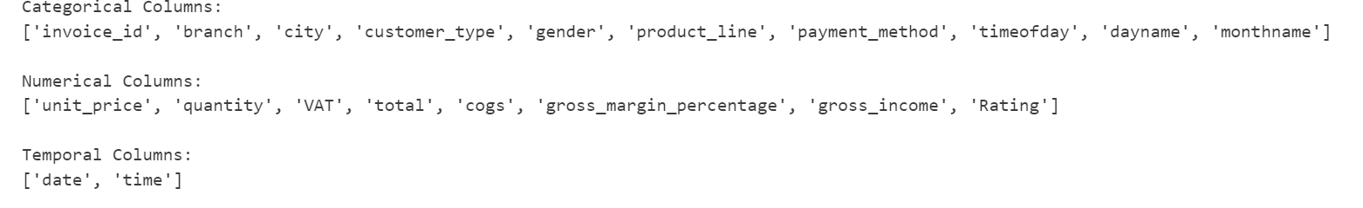
Exploratory Data Analysis (EDA) Part-3(Missing values) and converting the columns into appropriate datatypes

Slide 9
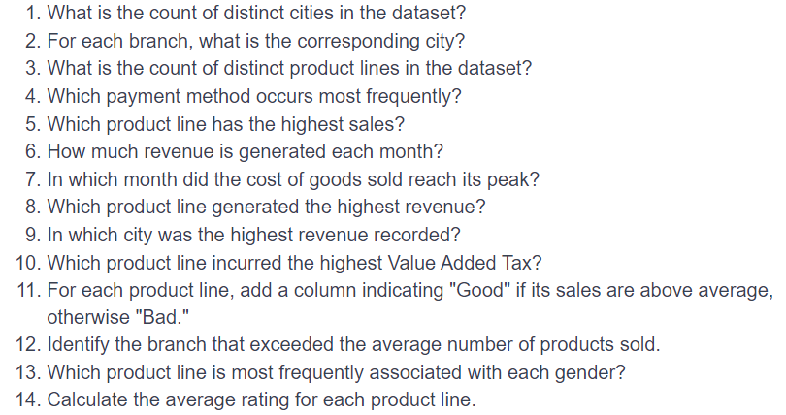
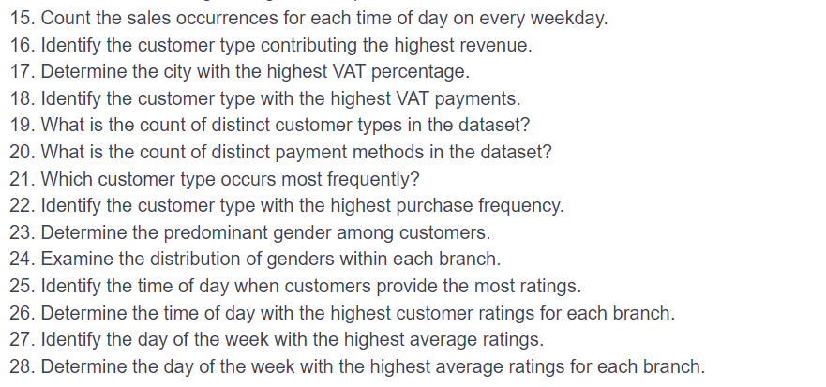
Business Questions

Slide 10
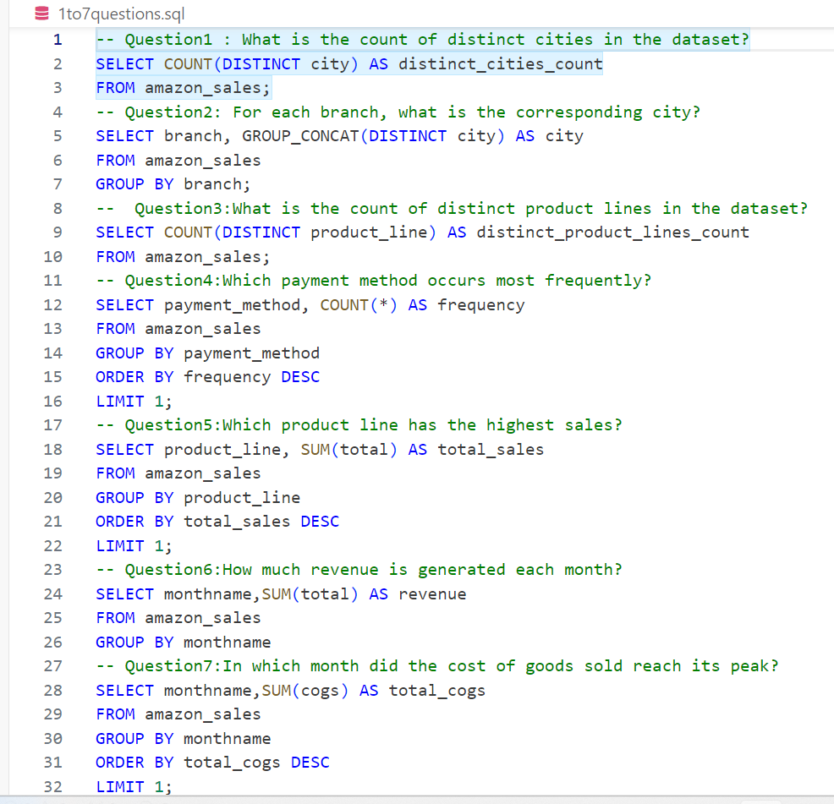
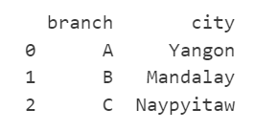
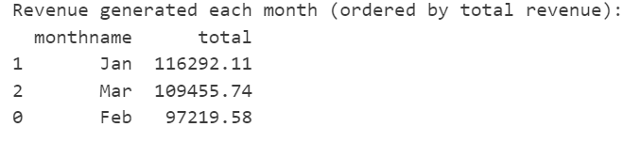
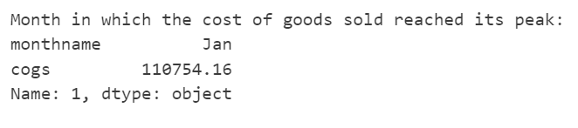

Slide 11
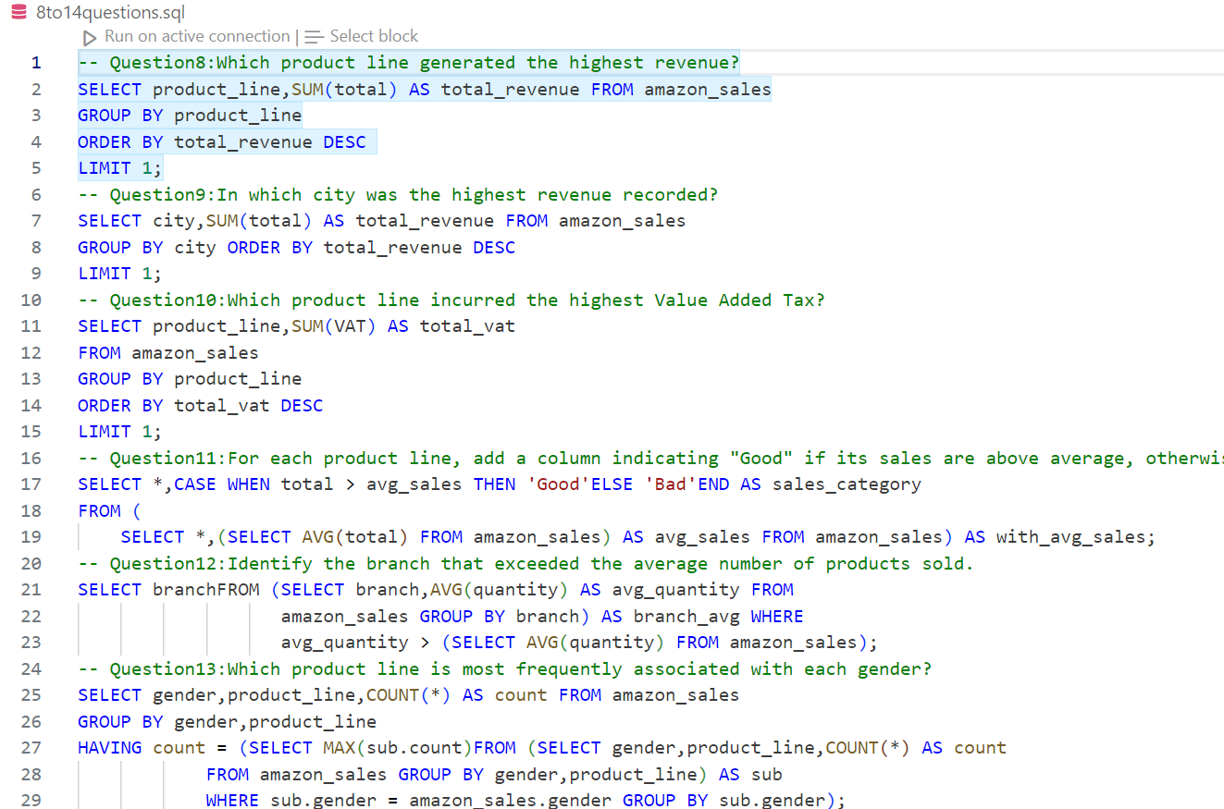
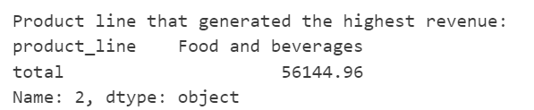
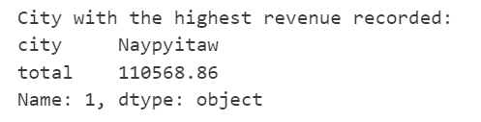
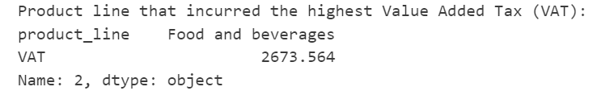
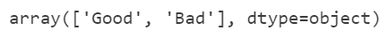
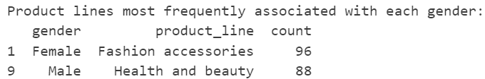
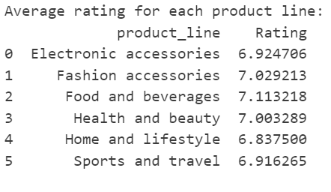

Slide 12
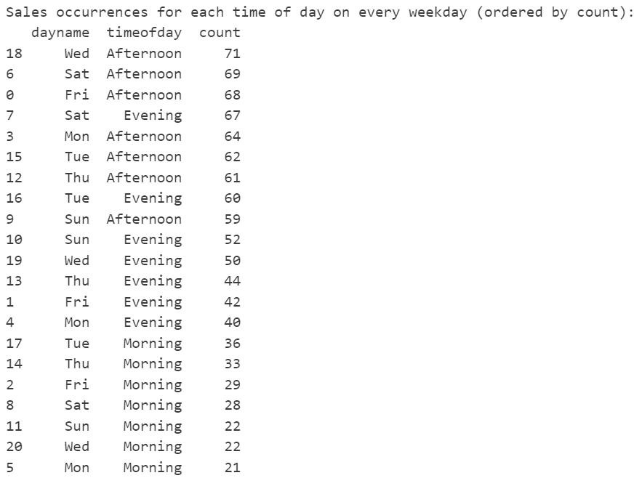
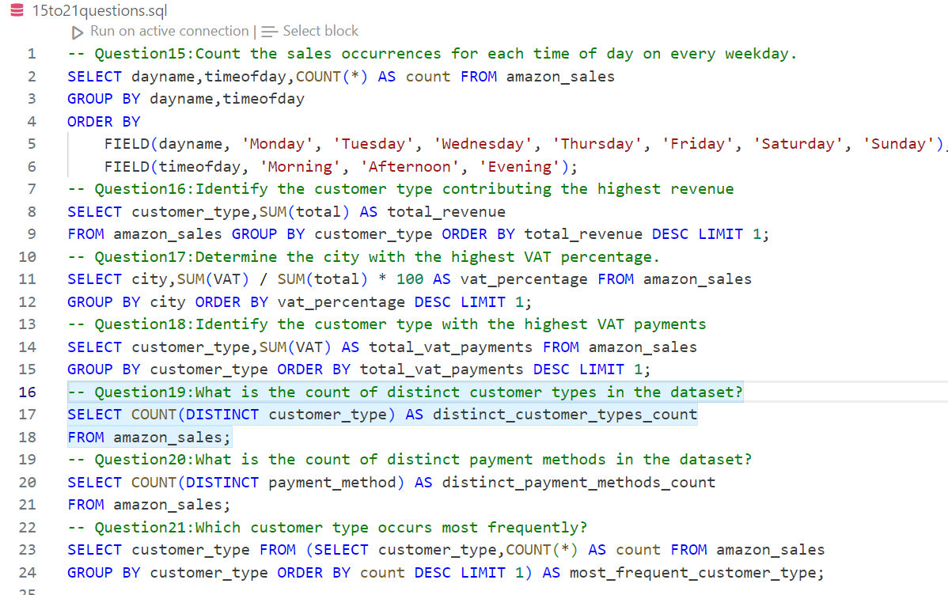
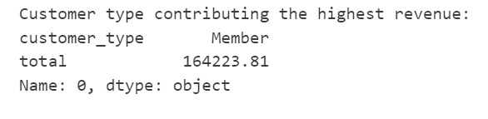
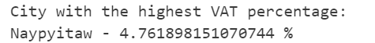
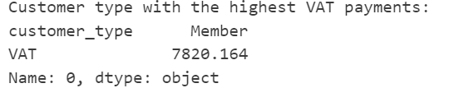

Slide 13
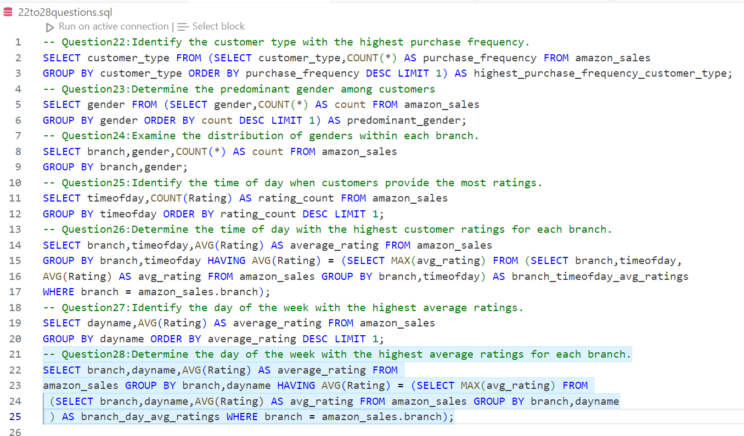
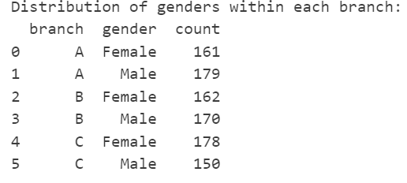
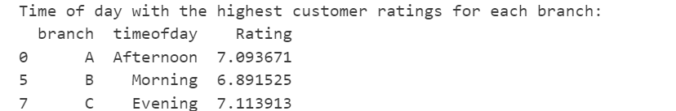
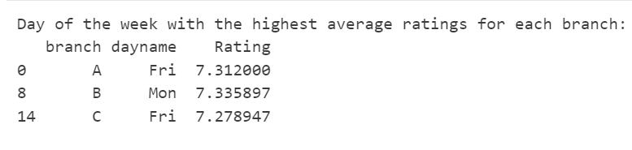

Slide 14

Thank you!!!!!!

